Slide 1
Data Communication and Computer Networks

Slide 2
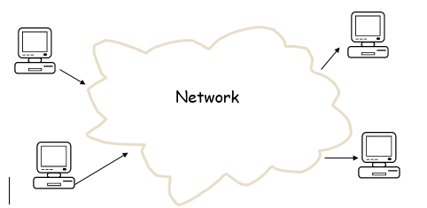
A computer network can be defined as two or more computers connected
together in such a way that they can share resources.
The purpose of a network is to share resources.
.

Slide 3
A resource may be:
A file
A folder
A printer
A disk drive
Or just about anything else that exists on a computer.
.

Slide 4
Advantages of networking
Connectivity and Communication
Data Sharing
Hardware Sharing
Internet Access
Entertainment
.

Slide 5
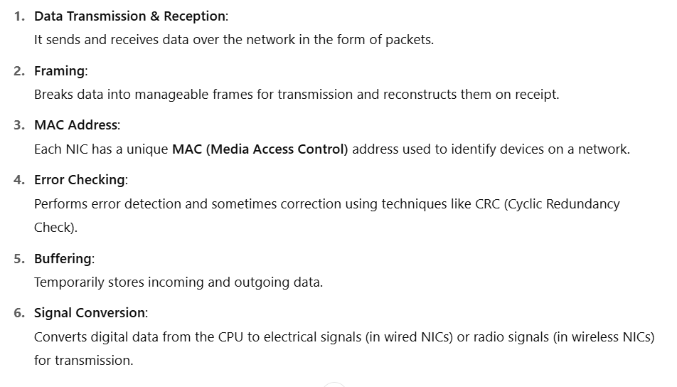
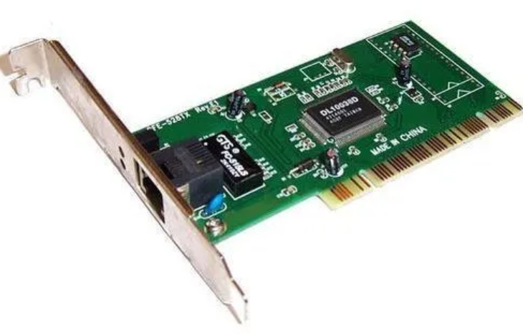
Network Interface Card
MAC Address
MAC (Media Access Control)
.

Slide 6
Network Topology
Bus topology
Ring topology
Star topology
Mesh topology
.

Slide 7
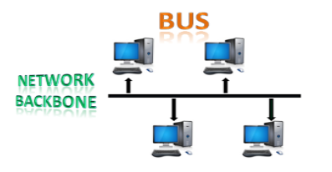
Bus topology
All the stations are connected through a single cable known as a backbone cable.
When a node wants to send a message over the network, it puts a message over the network. All the stations available in the network will receive the message whether it has been addressed or not.
Most common access method of the bus topologies is CSMA (Carrier Sense Multiple Access)
.

Slide 8

Ring topology
Node that receives the message from the previous computer will retransmit to the next node.
The data in a ring topology flow in a clockwise direction.
The most common access method of the ring topology is token passing.
Token: It is a frame that circulates around the network.
.

Slide 9

star topology
.

Slide 10

mesh topology
Mesh technology is an arrangement of the network in which computers are interconnected with each other through various redundant connections.
There are multiple paths from one computer to another computer.
Does not contain the switch, hub which acts as a central point of communication.
.

Slide 11
Types of Network
Local Area Network (LAN)
Metropolitan Area Network (MAN)
Wide Area Network (WAN)
.

Slide 12
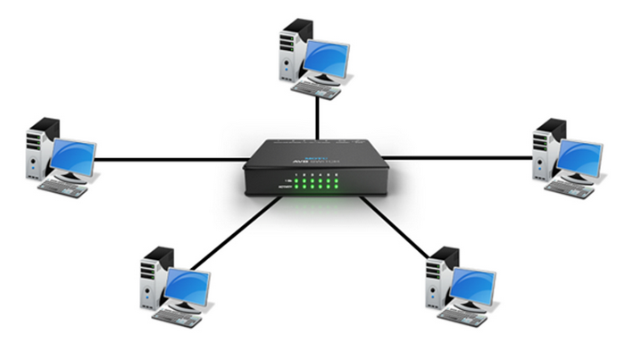
Network Devices
HUB
SWITCH
ROUTER
.

Slide 13
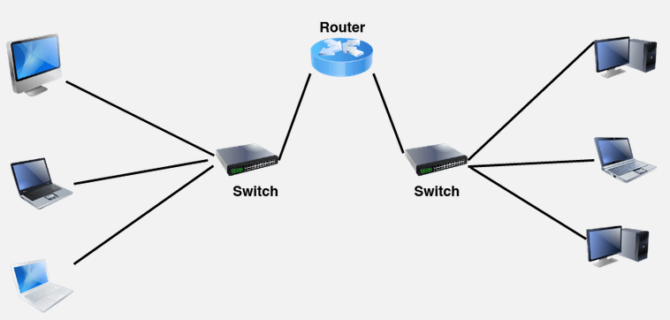
Network Devices
HUB
SWITCH
ROUTER
.

Slide 14
Protocol and Standards
A protocol is a set of rules that governs communication.
The key elements of a protocol are syntax, semantics, and timing.
Syntax. Syntax refers to the structure or format of the data, meaning the order in which they are presented.
Semantics. Semantics refers to the meaning of each section of bits.
Timing. Timing refers to two characteristics: when data should be sent and how fast it can be sent.
.

Slide 15
Protocol and Standards
Standards are essential in creating and maintaining an open and competitive market for equipment manufacturers and also in guaranteeing national and international interoperability of data and telecommunications technology and processes.
.

Slide 16

Layered Architecture
ISO : international organization for standardization
OSI : Open System interconnection model
.

Slide 17
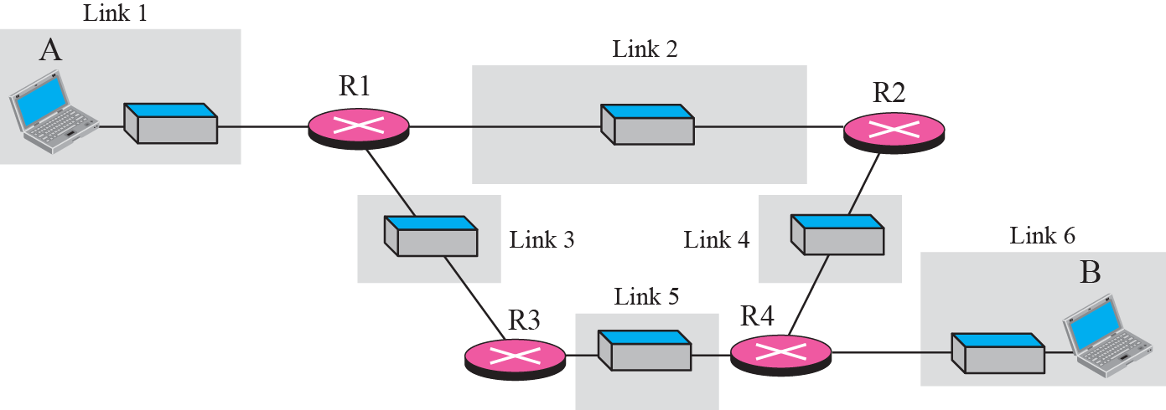
.

Slide 18
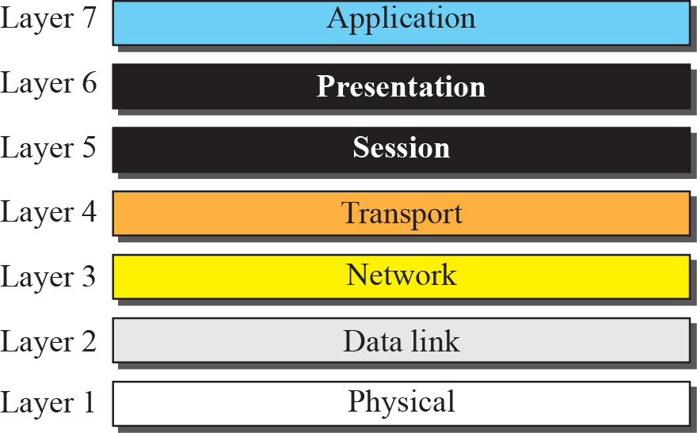
.

Slide 19
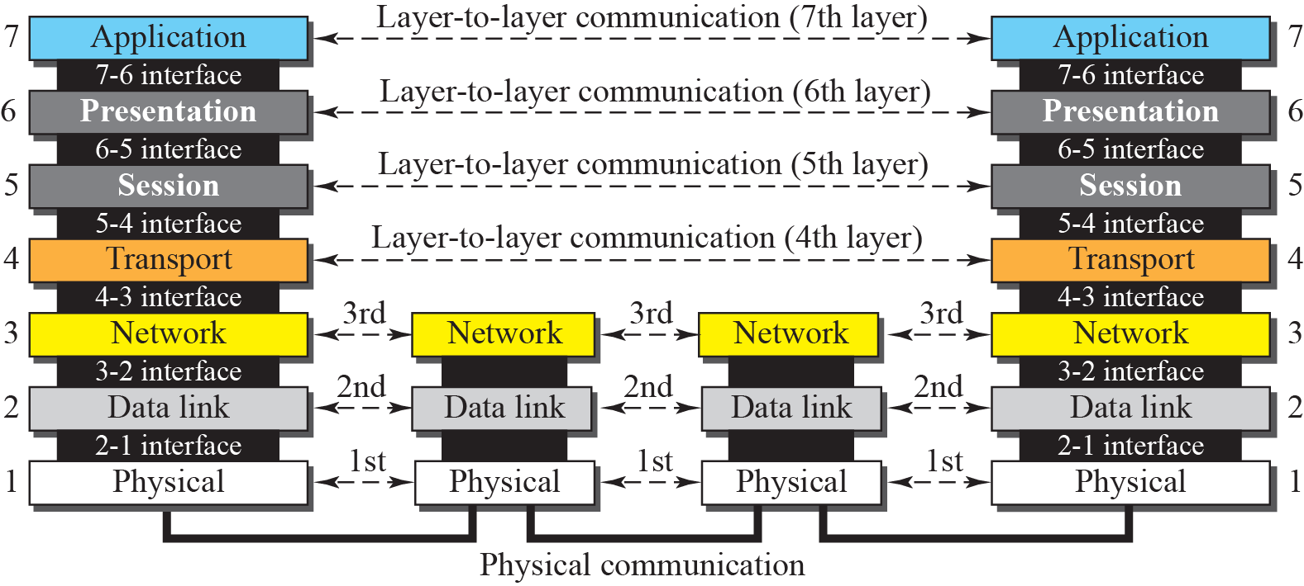
.

Slide 20
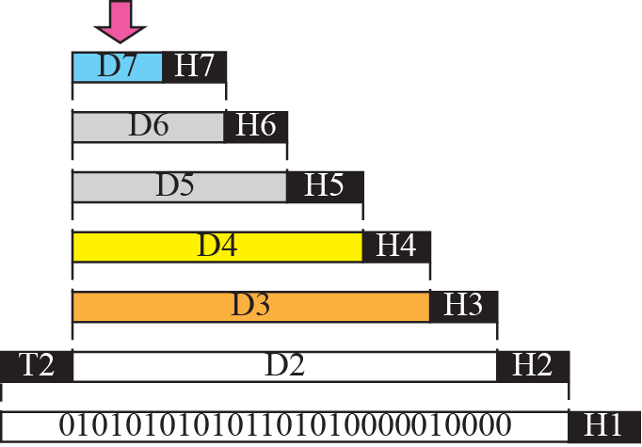


.

Slide 21
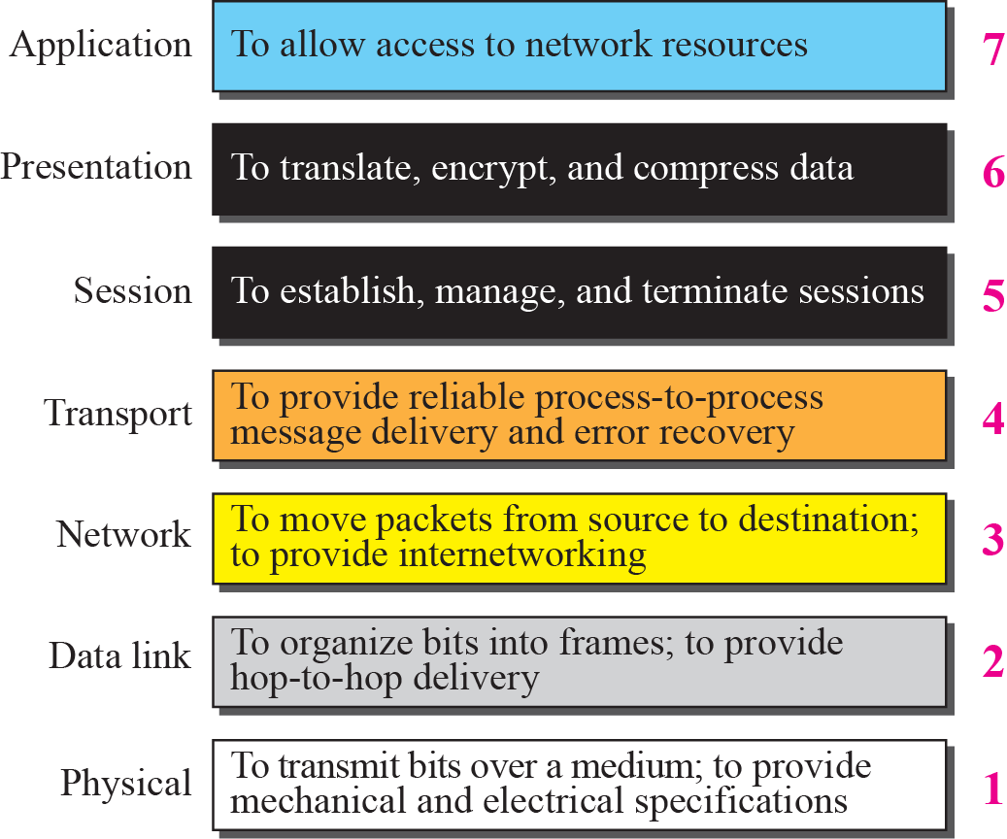
.

Slide 22
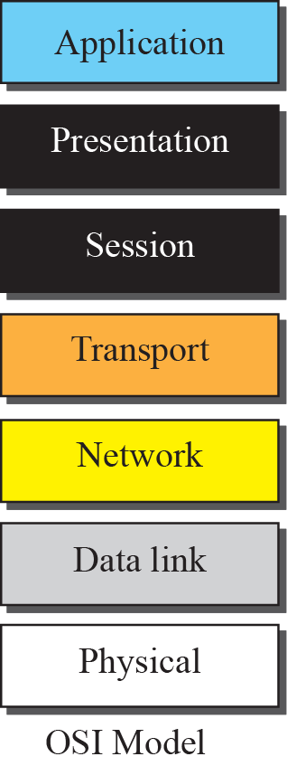
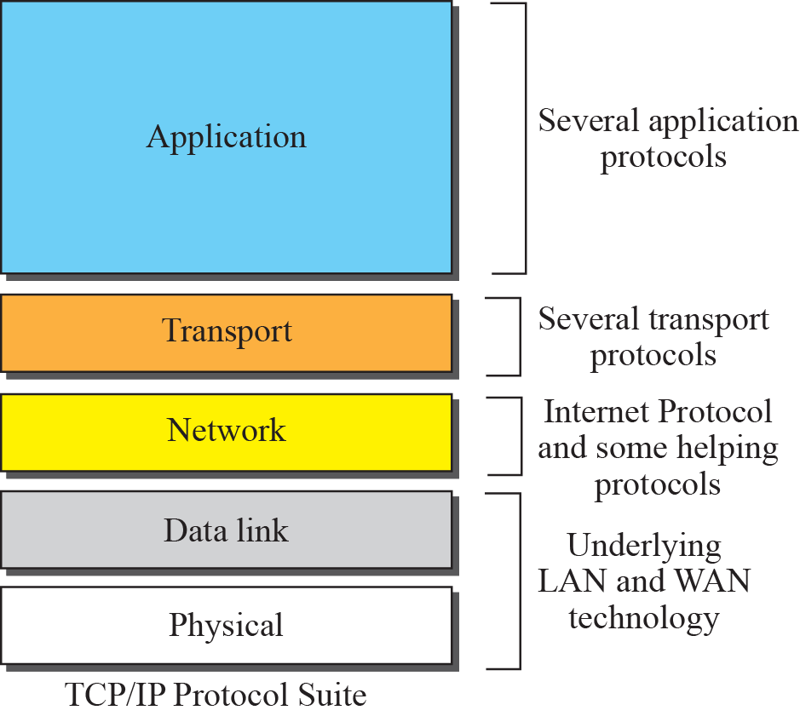
.

Slide 23
.

Slide 24
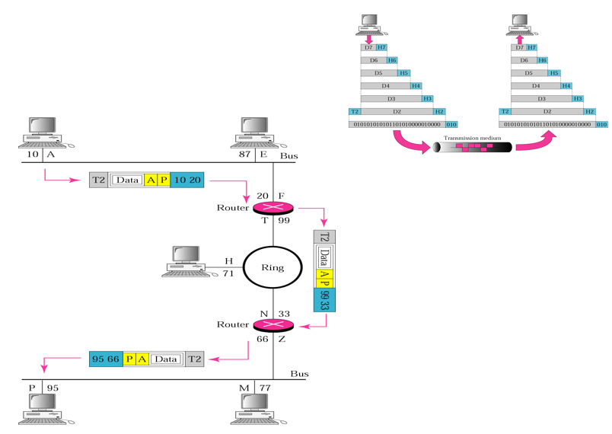
A P – ip address
10 95 mac address
.

Slide 25
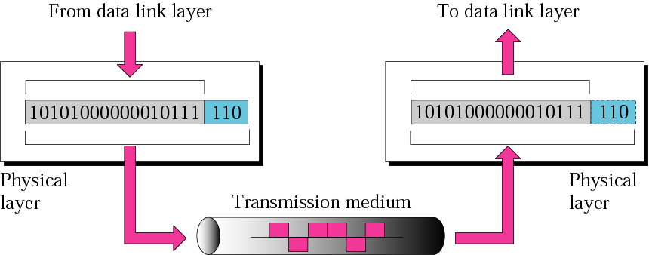
Physical Layer
The physical layer coordinates the functions required to carry a bit stream over a physical medium.
.

Slide 26
The physical Layer is also concerned with
Physical characteristics of interfaces and media : Connector type, port type
Representation of bits : Signalling(digital/Optical), Coding/encoding Schemes
Data rate : number of bits sent each second
Synchronization of bits :The sender and receiver must not only use the same bit rate but must also be synchronized at the bit level.
Line configuration : (point-to-point/Multi point)
Physical topology
Transmission mode : Simplex/Half-Duplex/Full-Duplex
.

Slide 27
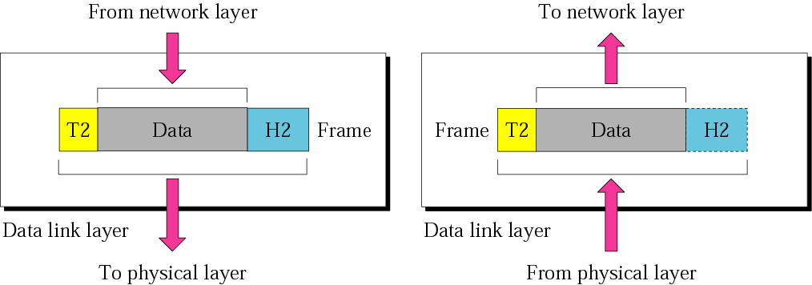
Datalink Layer
The data link layer is responsible for moving frames from one hop (node) to the next hop.
The data link layer functionality is usually split it into logical sub-layers, the upper sub-layer, termed as LLC(Logical Link Control) ., that interacts with the network layer above and the lower sub-layer, termed as MAC (Media Access Control), that interacts with the physical layer
.

Slide 28
The responsibilities of the data link layer include the following
Framing.
Physical addressing
Flow control.
Error control.
Access control.
.

Slide 29
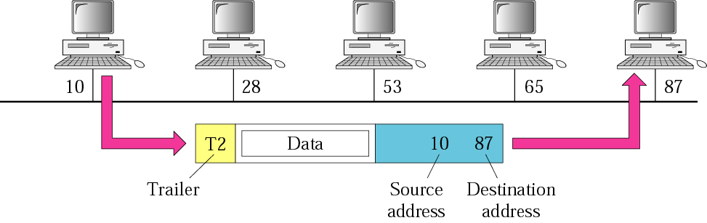
Physical addresses
.

Slide 30
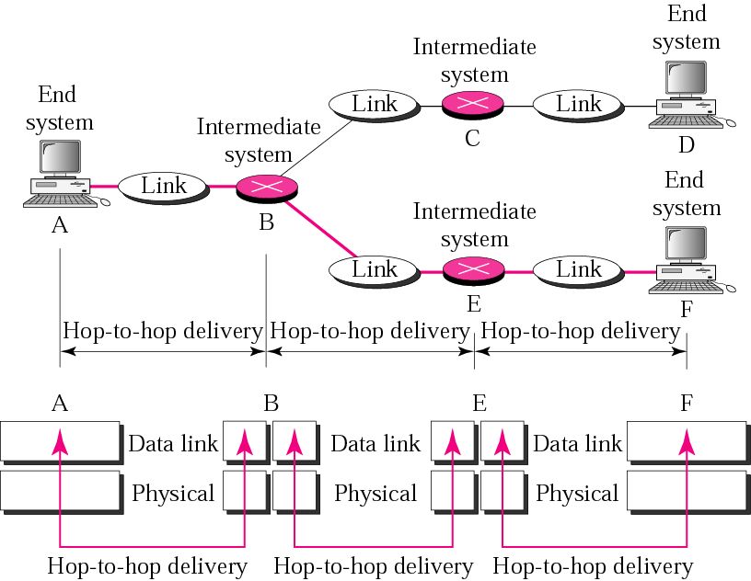
Hop-to-hop delivery
.

Slide 31
Error Detection and Correction
TYPES OF ERRORS
Data can be corrupted during transmission.
For reliable communication, errors must be detected and corrected.
Two types of errors:
  single-bit error
  burst errors.
.

Slide 32
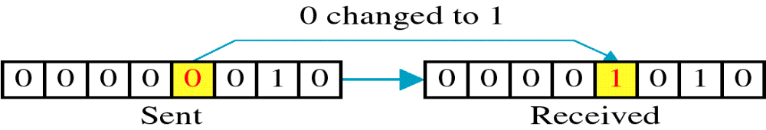
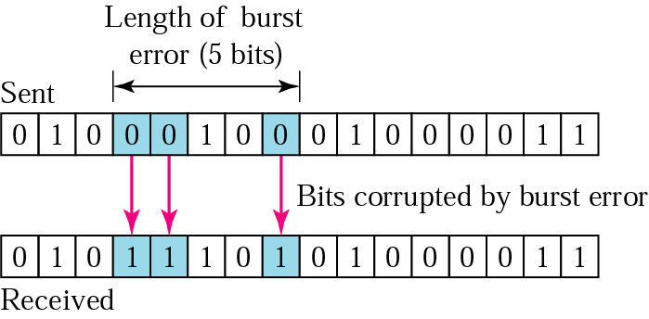
TYPES OF ERRORS
single-bit error: only one bit of a given data unit is changed from 1 to 0 or 0 to 1.
burst error: 2 or more bits in the data unit have changed from 1 to 0 or from 0 to 1.
A burst error does not mean that the errors occur in consecutive bits.
Length of the burst is measured from the first corrupted bit to the last corrupted bit
.

Slide 33
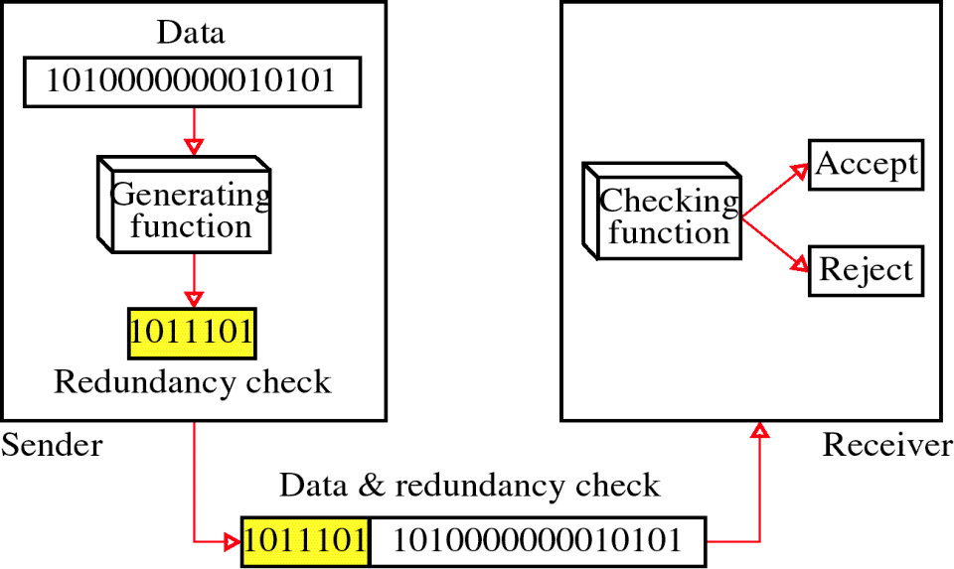
Redundancy
To detect or correct errors we need to send redundant bits with data.
These redundant bits are added by sender and removed by receiver.
Error detection uses the concept of redundancy, which means adding extra bits for detecting errors at the destination.
.

Slide 34
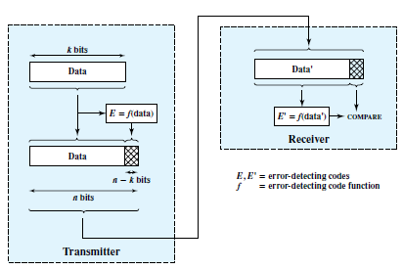
ERROR DETECTION
Error-detecting techniques operate on the following principle.
Figure 6.3 Error Detection Process
.

Slide 35
ERROR DETECTION
Parity Check
Simplest error-detecting scheme is to append a parity bit to the end of a block of data.
A typical example is character transmission, in which a parity bit is attached to each 7-bit character.
The value of this bit is selected so that the character has an even number of 1s (even parity) or an odd number of 1s (odd parity).
.

Slide 36
ERROR DETECTION
Cyclic Redundancy Check (CRC)
One of the most common, and most powerful, error-detecting codes.
Given a k-bit block of bits, the transmitter generates an (n – k) bit sequence, known as a frame check sequence (FCS), such that the resulting frame, consisting of n bits, is exactly divisible by some predetermined number.
The receiver then divides the incoming frame by that number and, if there is no remainder, assumes there was no error.
.

Slide 37

Cyclic Redundancy Check (CRC)
Modulo 2 Arithmetic :
uses binary addition with no carries, which is just XOR operation.
Binary subtraction with no carries is also interpreted as the XOR operation:
Example
.

Slide 38
ERROR DETECTION
Cyclic Redundancy Check (CRC)
Modulo 2 Arithmetic :
T = n bit frame to be transmitted.
D = k bit block of data, or the first k bits of T
F = ( n – k ) bit FCS, the last ( n – k ) bits of T
P = pattern of n – k + 1 bits; this is the predetermined divisor.
We would like T/P to have no remainder. It should be clear that
T = 2^{n-k} D + F
Multiplying D by 2^{n-k}, we have in effect shifted it to the left by n-k bits and padded out the result with zeros.
Adding F yields the concatenation of D and F, which is T.
.

Slide 39


Cyclic Redundancy Check (CRC)
Modulo 2 Arithmetic
T = 2^{n-k} D + F
We want T to be exactly divisible by P.
Suppose that we divide 2^{n-k}D by P
There is a quotient and a remainder.
In division is modulo 2, the remainder is always at least one bit shorter than the divisor.
We will use this remainder as our FCS. Then
.

Slide 40



Cyclic Redundancy Check (CRC)
Modulo 2 Arithmetic
Does this R satisfy our condition that T/P have no remainder?
To see that it does, consider
Substituting Equation (6.1), we have
Any binary number added to itself modulo 2 yields zero. so
There is no remainder, and therefore T is exactly divisible by P.
.

Slide 41
Cyclic Redundancy Check (CRC)
Modulo 2 Arithmetic
Thus, FCS is generated by dividing 2^{n-k}D by P and use (n-k) remainder as the FCS.
On reception, receiver will divide T by P and will get no remainder if there have been no errors.
.

Slide 42
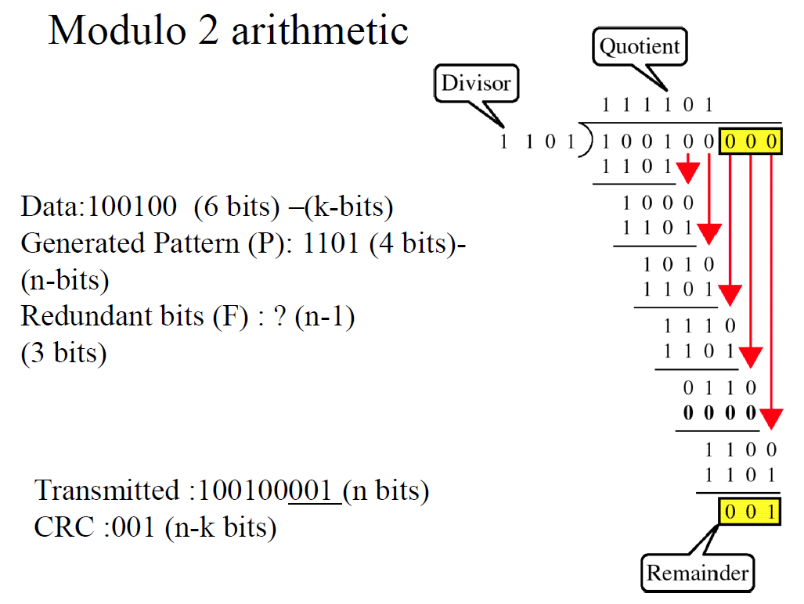
.

Slide 43
A Data D=1010001101 to be transmitted and the given pattern is P = 110101.
What is the transmitted message ?
Also verify the message at the receiver.
.

Slide 44
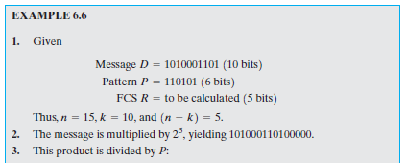
Cyclic Redundancy Check (CRC)
Modulo 2 Arithmetic
.

Slide 45
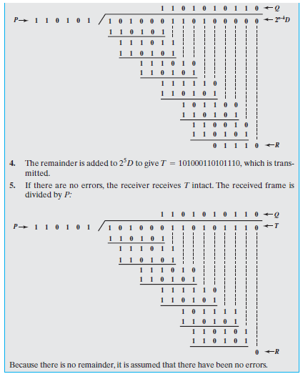
Cyclic Redundancy Check (CRC)
Modulo 2 Arithmetic
.

Slide 46

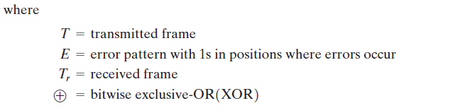
Cyclic Redundancy Check (CRC)
Modulo 2 Arithmetic
An error results in the reversal of a bit.
The resulting frame can be expressed as
.

Slide 47
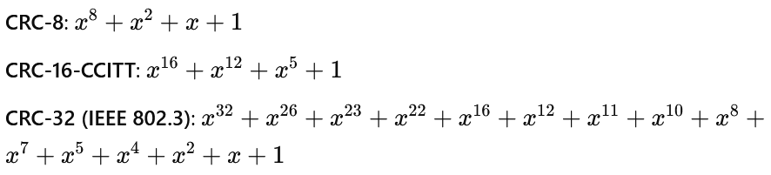
Cyclic Redundancy Check (CRC)
Modulo 2 Arithmetic
The pattern P is chosen to be one bit longer than the desired FCS, and the exact bit pattern chosen depends on the type of errors expected.
At minimum, both the high- and low-order bits of P must be 1.
Standard Polynomials
There aren't strict "hard-coded" rules for selecting the divisor (generator polynomial) in CRC, but there are well-established guidelines and best practices that have been developed through extensive research and practical experience.
.

Slide 48
Hamming Code
Hamming Code is an error detection and correction code developed by Richard W. Hamming.
To detect and correct single-bit errors.
Number of redundancy bits needed
Let data bits = m
Redundancy bits = r
∴Total message sent = m+r
The value of r must satisfy the following relation:
2^{r} ≥ m+r+1
.

Slide 49
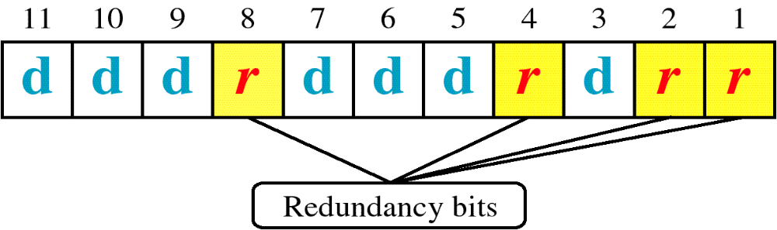
Hamming Code
.

Slide 50
Hamming Code
Find the additional bits required to send the following bits:
1001101
.

Slide 51
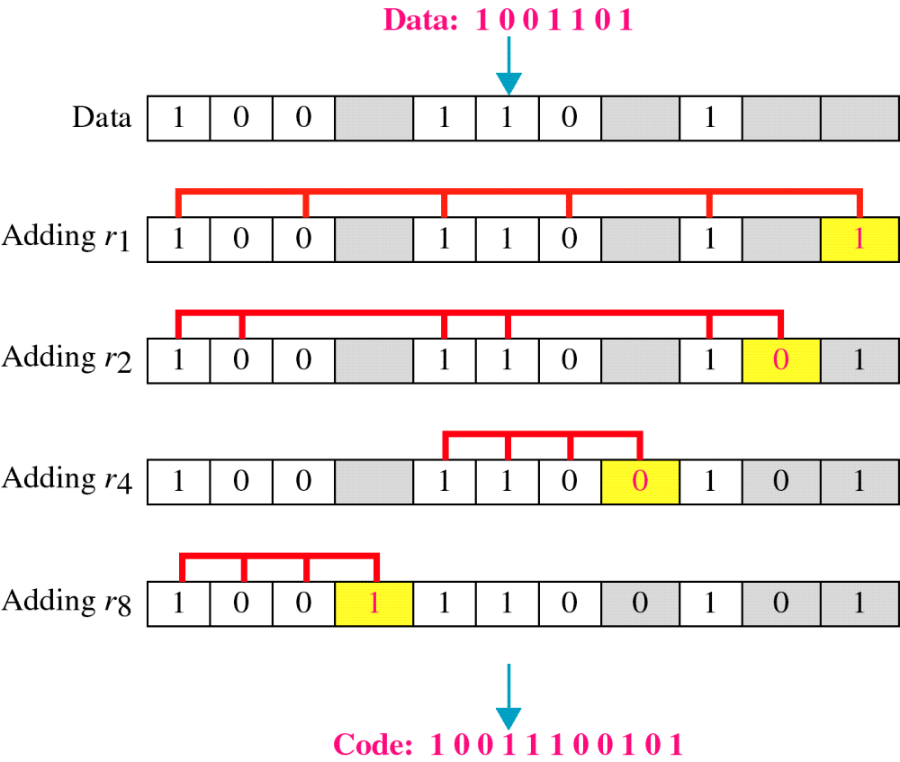
Hamming Code
.

Slide 52
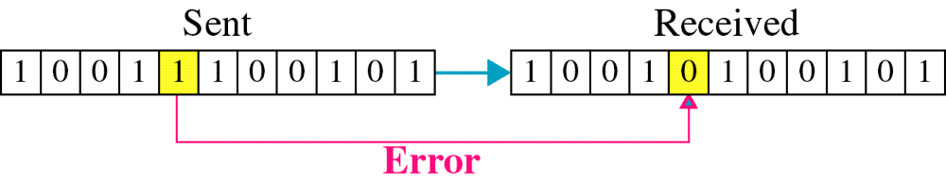
Hamming Code
Single-bit error
.

Slide 53

Hamming Code
Error
Detection
.

Slide 54
Tutorial 3
Consider a device A which has to send the data bits ‘1101” to another device B. Compute the hamming code generated by device A
Consider a scenario to send the data bits ‘101100100001” to receiver. Compute the hamming code generated by sender.
.

